Slide 1
IM Injections and Handling of Hazardous Drugs
Jackie McCready, MSN, RN-C(OB), RN-BC
Nurse educator, gyn/ob, johns Hopkins hospital

Slide 2
POLICY CONSIDERATIONS
Chemotherapy Policy
Appendix A – Chemotherapy Agents – Methotrexate (p.2)
Doses given more than once a week are not exempt unless give for ectopic pregnancy
Ectopic pregnancy – see policy – Methotrexate for Ectopic Pregnancy, Management of Patient Receiving (MDU051)
Newly updated, December 2017

Slide 3
Methotrexate Administration
Ventrogluteal IM Injection
SITE IDENTIFICATION
INJECTION TECHNIQUE
Safe Handling Techniques
PPE
DISPOSAL

Slide 4
VENTROGLUTEAL INJECTION

Slide 5
VENTROGLUTEAL INJECTION
VIDEO AND IMAGES
Demo
Notes:
Animated video – go to 1:07 min mark – play through to 2:15
Live demo – go to 1:06 (2 ID and verify allergies) 2:30- 3:04 then

Slide 6
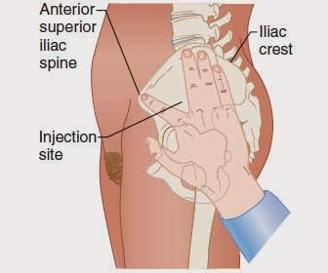
VENTROGLUTEAL INJECTION
MORE IMAGES
Notes:
Animated video – go to 1:07 min mark – play through to 2:15
Live demo – go to 1:06 (2 ID and verify allergies) 2:30- 3:04 then

Slide 7
DORSOGLUTEAL SITE
Consider patient positioning – requires prone position
Demo

Slide 8
LET’S COMPARE
VENTROGLUTEAL
DORSOGLUTEAL

Slide 9
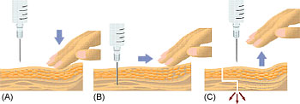
A WORD ABOUT Z-TRACK
NOT REQUIRED FOR THIS MEDICATION!

Slide 10
SAFE HANDLING
MTX (Methotrexate) is a chemotherapeutic agent and is subject to policies for handling hazardous drugs
All hazardous drugs dispensed by a JHH pharmacy will be labeled with a bright orange sticker
Chemotherapy will also include a
second sticker

Slide 11
What does that mean for you?
NOTE: eye/face protection optional – (splash)
2 pairs of gloves
Gown
Under-glove tucked into gown sleeve
Over-glove overtop of gown sleeve
1st pair (under-glove)
2nd pair (over-glove)

Slide 12
What about when you’re done?
Engage safety mechanism on needle
Return BOTH syringe and needle to plastic bag
Dispose of BAG, SYRINGE AND NEEDLE in REGULAR sharps container

Slide 14
Upon completion of this course, please send Dr Frank Witter an e-mail attesting to your knowledge of this information and agreement to follow applicable policies.
A copy of this e-mail will be maintained for regulatory purposes.
THANK YOU!

